Slide 1
Randomized algorithms 4 Distributed computing
CS240 Spring 2024
Rui Fan

Slide 2
Distributed computing
Distributed system
Set of autonomous nodes, working independently of each other.
Nodes may be able to communicate, at a cost.
Ex Internet, computer cluster, sensor network.
Nodes need to coordinate to solve some problem.
Coordination can be done using communication. But communication is expensive.
By making nodes randomized, they can coordinate with minimal communication.
Randomization also simplifies symmetry breaking between nodes.
Today we’ll look at randomized contention resolution and maximal independent set.

Slide 3
Contention resolution
Set of n nodes (e.g. cellphones) want to send each other messages.
Only one node can send at a time.
If two nodes send at same time, their signals interfere and both transmissions fail.
Nodes can’t communicate.
Communicating requires sending messages, which is the problem we’re trying to solve!
Nodes can’t coordinate to work out a schedule. They have to randomize.

Slide 4
Contention resolution
Assume system is synchronous.
Nodes work in rounds.
Each node can try to send once per round. It succeeds if and only if it’s the only node to try to send in that round.
Algorithm Each node tries to send with probability 1/n in every round.

Slide 5
Analysis
How many rounds before all the nodes can send?
Let S_{i,t} be the event that node i successfully sends in t’th round.
S_{i,t} occurs iff i tries to send in t’th round and all other nodes do not.
Pr[S_{i,t}]=1/n*(1-1/n)^{n-1}.
i tries to send with prob. 1/n, and each of i’s n-1 neighbors don’t send with prob. 1-1/n.
Fact For all n≥2, 1/e ≤ (1-1/n)^{n-1} ≤ ½, and ¼ ≤ (1-1/n)^{n} ≤ 1/e.
So Pr[S_{i,t}] ≥ 1/en.
Pr[i fails to send in t’th round] = 1- Pr[S_{i,t}] ≤ 1-1/en.

Slide 6
Analysis
Thm After 2e*n ln(n) rounds, all nodes succeed sending with probability ≥ 1-1/n.
Proof Let F_{i} denote event that node i fails to send after 2e*n ln(n) rounds, and let F denote event that any node fails to send after 2e*n ln(n) rounds.
Pr[F_{i}] ≤ (1-1/en)^{2e*n ln(n)} ≤ (1/e)^{2 ln(n)} ≤ 1/n².
In each round i fails independently with prob. ≤ (1-1/en).
Pr[F] ≤ Σ_{i} Pr[F_{i}] ≤ n*1/n²=1/n, by the union bound.
So all nodes succeed with prob. ≥ 1-1/n.

Slide 7
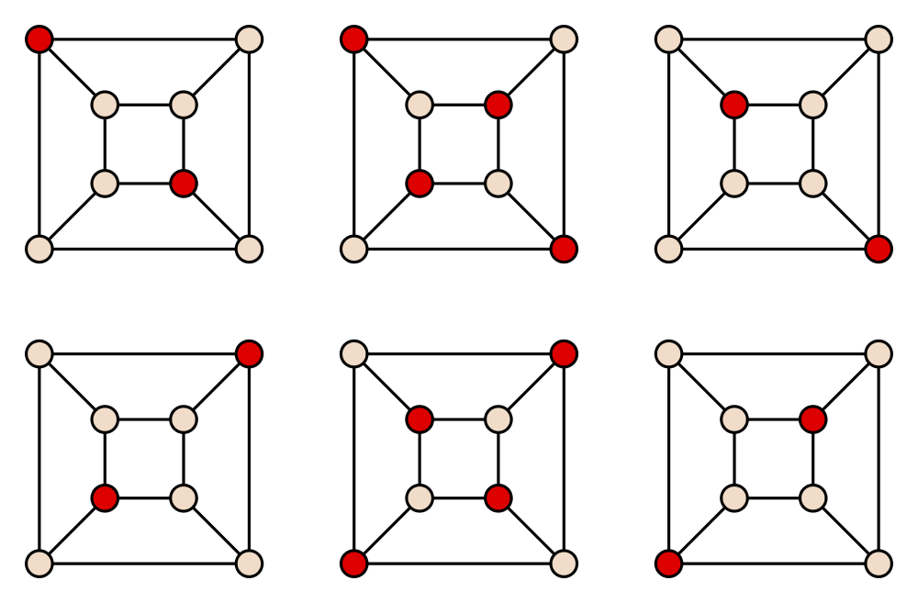
Maximal independent set
Given a graph, an independent set is a set of vertices, none of which are connected to each other.
A maximal independent set (MIS) is an independent set such that if we add any other vertex, it would be connected to some vertex in the independent set.
I.e. An MIS can’t be made any larger.
A maximum independent set (MaxIS) is an independent set of maximum cardinality in the graph.
Note that an MIS might not be a MaxIS. An MIS is a “local” max, while a MaxIS is the “global” max.
All 6 MIS’s of the cube graph. Note only the two center MIS’s are MaxIS.

Slide 8
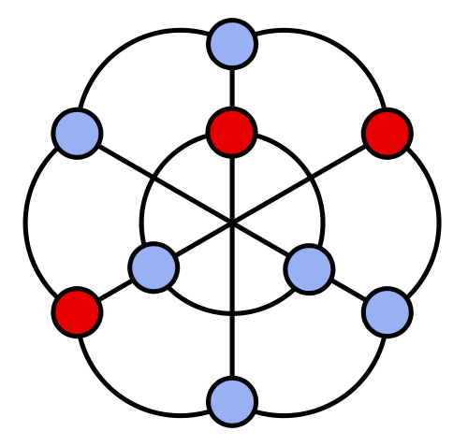
Distributed MIS
Compute an MIS on a network of n nodes.
The MIS nodes can be “leaders”, used to coordinate the other nodes in some distributed computation.
A simple algorithm is to continually add a node to the MIS, then remove its neighboring nodes and edges, then repeat.
This algorithm takes O(n) time.
It’s also sequential. We have to remove all the neighbors of a selected node before we select the next node.
Otherwise we can add two neighboring nodes both to the MIS.
We want a fast, distributed MIS algorithm.

Slide 9
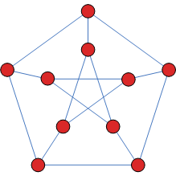
Distributed MIS
Again consider synchronous model where all nodes work in rounds.
Each node can broadcast a message to its neighbors in each round.
Each node v chooses a random number r(v)∈[0,1] and sends it to its neighbors.
If r(v)<r(w) for all neighbors w of v, then v adds itself to the MIS and informs its neighbors.
If v or one of its neighbors entered the MIS, v terminates. Remove all of v’s edges.
Otherwise go back to first step, until graph is empty.
Call these three steps a phase.
Assume no ties, i.e. for any u,v, either r(u)<r(v) or vice versa.

Slide 10
Analysis
We show this algorithm outputs an MIS, and terminates quickly.
The output is an independent set.
For every two neighbors, only the one with smaller r value can join MIS.
When a node joins the MIS, all its neighbors are removed and can’t join the MIS.
It’s a maximal IS because we only ever take away a node if its neighbor is in the MIS.

Slide 11
Analysis
0.6
0.5
How many rounds does it take to terminate?
Lemma In each phase, at least half the edges are removed in expectation.
We’ll prove this after proving Claims 1-4.
Def Let u, v be two nodes. Say u preemptively removes v if u∈N(v), and r(u)<r(u’) for all u’∈N(u)∪N(v)\{u}.
Denote as u<<v.
Given an edge e=(v,w), we say e is preemptively removed by u if u<<v.
Claim 1 For any v, there’s at most one u s.t. u<<v.
Proof If u<<v, then u is the neighbor of v with min r value.
u
v
0.8
0.1
0.4
0.2
0.3

Slide 12
Analysis
0.6
0.5
Let P = {all preemptively removed edges in phase}, R = {all edges removed in phase}.
Claim 2 P⊆R
Let e=(v,w)∈P. Then v has nbr u s.t. r(u)<r(u’) for all u’∈N(u)∪N(v)\{u}.
So u will get removed.
So v is also removed. All edges incident to v, including e, are also removed. So e∈R.
Let X_{u<<v}=1 if u<<v and 0 otherwise.
If X_{u<<v}=1, all edges incident to v are removed.
So if X_{u<<v}=1, d(v) edges get removed, where d(v) is degree v.
e
u
v
0.8
0.1
0.4
0.2
0.3

Slide 13
Analysis
Claim 3 Σ_{u} Σ_{v∈N(u)} X_{u<<v}*d(v) ≤ 2*|P|.
Given any edge e=(v,w), the sum counts e once each time e is preemptively removed by some other node u.
How many such u’s are there?
u preemptively removes e only if u<<v or u<<w.
By claim 1, there’s only at most one u that << v, and at most one that << w.
So e is preemptively removed by at most 2 other nodes.
So any e in the sum is a preemptively removed edge that’s counted at most twice.
Since P is set of all preemptively removed edges, then the sum ≤ 2*|P|.
Cor 1 Σ_{u} Σ_{v∈N(u)} X_{u<<v}*d(v) ≤ 2*|R|.
Because P⊆R by Claim 2.

Slide 14
Analysis
Claim 4 E[Σ_{u} Σ_{v∈N(u)} X_{u<<v}*d(v)] ≥ |H|, where H={edges}.
For any u and v∈N(u), E[X_{u<<v}*d(v)]=Pr[u<<v]*d(v).
u<<v only if r(u)<r(u’) for all u’∈N(u)∪N(v)\{u}.
There are at most d(u)+d(v) nodes in N(u)∪N(v)\{u}.
Each node picks a random value r. Probability it’s min among ≤ d(u)+d(v) random values is ≥ 1/(d(u)+d(v)).
So Pr[u<<v] ≥ 1/(d(u)+d(v)).
So E[X_{u<<v}*d(v)] ≥ d(v)/(d(u)+d(v)).
E[Σ_{u} Σ_{v∈N(u)} X_{u<<v}*d(v)] =
Σ_{e=(u,v)∈H} (E[X_{u<<v}*d(v)] + E[X_{v<<u}*d(u)]) ≥
Σ_{e=(u,v)∈H} d(v)/(d(u)+d(v)) + d(u)/(d(u)+d(v)) =
Σ_{e=(u,v)∈H} 1 = |H|.

Slide 15
Analysis
Proof of Lemma
By Claim 4 and Cor. 1, |H| ≤ 2*E[|P|] ≤ 2*E[|R|].
So E[|R|] ≥ |H|/2, i.e. half the edges get removed in expectation every phase.
Cor 2 With probability ≥ 1/3, at least 1/4 the edges get removed in every phase.
Otherwise, the probability less than 1/4 edges get removed every phase is greater than 2/3.
So expected number of edges removed in the phase is < 2/3*|H|/4+1/3*|H| = |H|/2, contradicting the lemma.
Thm The algorithm computes an MIS in 42*ln(n) phases with probability ≥ 1-1/n.

Slide 16
Analysis
Proof Say a phase is good if ≥ 1/4 the edges get removed.
So Pr[phase is good] ≥ 1/3 by Cor 2. Also, these probabilities are independent.
In 42*ln(n) phases, we expect ≥ μ=14*ln(n) good phases .
Pr[< 7*ln(n) good phases in 42*ln(n) phases] = Pr[number good phases< ½ expectation] ≤
e^{-14*ln(n)/8} <1/n, by Chernoff bounds.
If we get 7*ln(n) good phases, then fraction of remaining edges is ≤ (3/4)^{7*ln(n)} = n^{7*ln(3/4)} ≈ n^{-2.01}.
Since there are O(n²) edges, all the edges get removed after 7*ln(n) good phases. And we get 7*ln(n) good phases in 42*ln(n) phases with probability > 1-1/n.

